Slide 1




JVM的那点事
AndyHoo

Slide 2
类加载
类加载器，双亲委派机制,自定义类加载器
OOM
堆,栈,方法区,程序计数器，本地方法栈, client，server模式
JVM
GC
GC roots,GC分类,GC设置参数
jvm&synchronized
堆中的对象，对象头，monitor，synchronized

Slide 3


类加载
五个阶段
1.loading ---> 2.Verification ---> 3.Preparation --->4.Resolution--->5.Initialization

Slide 4

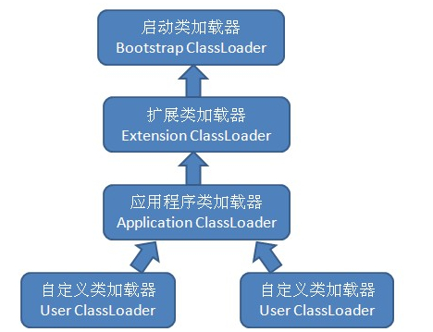



根类加载器 Bootstrap class loader
Class Loader
扩展加载器 Extension class loader
系统应用加载器 App class loader
用户自定义加载器 Customer class loader

Slide 5






类加载过程:
findLoadedClass(name)判断当前类是否已加载
否
双亲委托机制
初始化为系统类加载器
判断类加载器是否存在父类加载器
存在就交给父类加载
不存在就直接交给根类加载器
根类加载器无法加载的,自己尝试加载

Slide 6


public abstract class ClassLoader {
//...
//默认的类加载器为systemClassLoader
protected ClassLoader() {
SecurityManager security = System.getSecurityManager();
if (security != null) {
security.checkCreateClassLoader();
}
this.parent = getSystemClassLoader();
initialized = true;
}
public Class<?> loadClass(String name) throws ClassNotFoundException {
return loadClass(name, false);
}
protected Class<?> loadClass(String name, boolean resolve)
throws ClassNotFoundException
{
//对需要加载的class上锁
synchronized (getClassLoadingLock(name)) {
// First, check if the class has already been loaded
Class<?> c = findLoadedClass(name);
if (c == null) {
long t0 = System.nanoTime();
try {
if (parent != null) {
//如果存在父类加载器，交给父类加载器
c = parent.loadClass(name, false);
} else {
//如果不存在父类(根类无法被java调用)直接调用根类加载器
c = findBootstrapClassOrNull(name);
}
} catch (ClassNotFoundException e) {
// ClassNotFoundException thrown if class not found
// from the non-null parent class loader
}
if (c == null) {
// If still not found, then invoke findClass in order
// to find the class.
long t1 = System.nanoTime();
c = findClass(name);
// this is the defining class loader; record the stats
sun.misc.PerfCounter.getParentDelegationTime().addTime(t1 - t0);
sun.misc.PerfCounter.getFindClassTime().addElapsedTimeFrom(t1);
sun.misc.PerfCounter.getFindClasses().increment();
}
}
if (resolve) {
resolveClass(c);
}
return c;
}
}
少啰嗦，直接看代码

Slide 7


自定义类加载器
实现ClassLoader抽象类

Slide 8

商务介绍
01.
A guest with a web page version of the iPhone device A guest with a web page A guest with a
商务介绍
02.
A guest with a web page version of the iPhone device A guest with a web page A guest with a
商务介绍
03.
A guest with a web page version of the iPhone device A guest with a web page A guest with a

Slide 9


WHY CHOOSE US?
为什么选择我们​
A guest with a web page version of the iPhone device A guest with a
web page A guest with a web page version f the
商务介绍
商务介绍

Slide 10
PART.TWO
业务展示
A guest with a web page version of the iPhone device A guest with a web page A guest with a web page version
of the iPhone device A guest with a web page

Slide 11

商务介绍
商务介绍
商务介绍
1.
2.
3.
A guest with a web page version of the iPhone
A guest with a web page version of the iPhone
A guest with a web page version of the iPhone
商务介绍
商务介绍
商务介绍
4.
5.
6.
A guest with a web page version of the iPhone
A guest with a web page version of the iPhone
A guest with a web page version of the iPhone

Slide 12




项目介绍​
项目介绍​
项目介绍​
A guest with a web page version of the iPhone A guest with a web page version
A guest with a web page version of the iPhone A guest with a web page version
A guest with a web page version of the iPhone A guest with a web page version
568K
23.5%
10/8

Slide 13



2020
我们的业务品质​
A guest with a web page version of the iPhone device A guest with a web page A guest with a web
pageA guest with a web page version of the iPhone device

Slide 14
PART.THREE
项目汇报
A guest with a web page version of the iPhone device A guest with a web page A guest with a web page version
of the iPhone device A guest with a web page

Slide 15




+86%
我们的市场占比
A guest with a web page version of the iPhone device A guest with a web page A guest with a web
pageA guest with a web page version of the iPhone device
MORE

Slide 16



Business introduction
A guest with a web page version of the iPhone device A guest with a web page A guest with a web page version
of the iPhone device A guest with a web page
商务介绍

Slide 17
PART.FOUR
未来规划
A guest with a web page version of the iPhone device A guest with a web page A guest with a web page version
of the iPhone device A guest with a web page

Slide 18


商务介绍
商务介绍
A guest with a web page version of the iPhone device A guest with a web page A guest with a
A guest with a web page version of the iPhone device A guest with a web page A guest with a
商务介绍
商务介绍
A guest with a web page version of the iPhone device A guest with a web page A guest with a
A guest with a web page version of the iPhone device A guest with a web page A guest with a

Slide 19
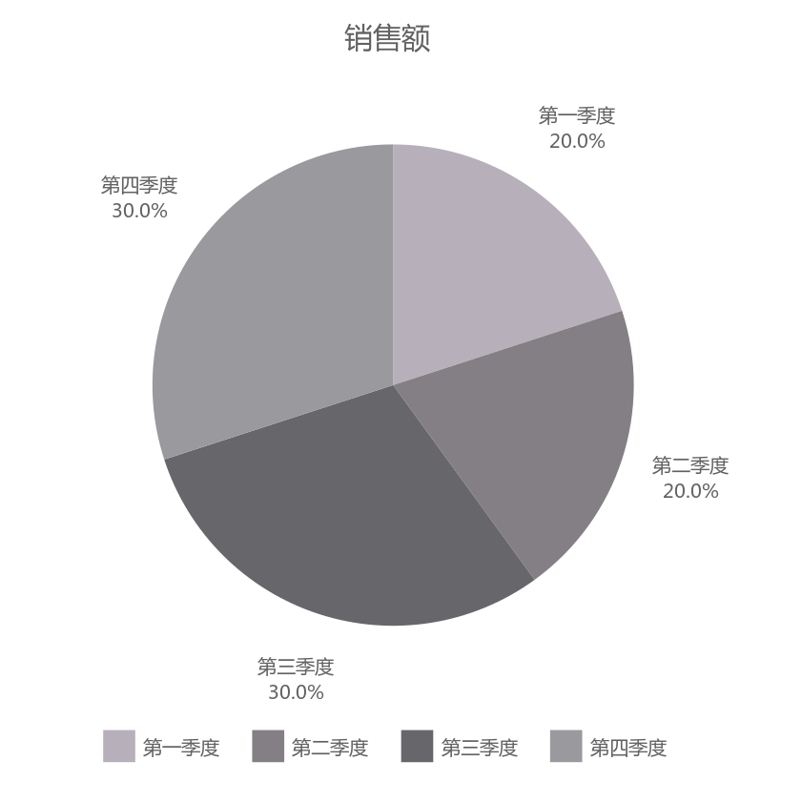
+86%
我们的市场占比
A guest with a web page version of the iPhone device A guest with a web page A guest with a web
pageA guest with a web page version of the iPhone device
MORE

Slide 20
THANK YOU
BUSINESS POWERPOINT
END

